Slide 1


APEX INSTITUTE OF TECHNOLOGY
DEPARTMENT OF COMPUTER SCIENCE & ENGINEERING
PostgreSQL (Winning Camp)
Faculty: Prof. (Dr.) Vineet Mehan (E13038)
Shell Environment, Basic Commands & Data types
DISCOVER . LEARN . EMPOWER

Slide 2
Course\Lecture Objective
The objective of the Course\Lecture is to
Make student understand the Shell Environment
Identify various commands of PostgreSQL
Understand various data types used in PostgreSQL
Create databases

Slide 3
Course\Lecture Outcome
After the completion of the Course\Lecture, student will be able to
Work in the Shell Environment
Write different PostgreSQL commands
Implement Data types in SQL
Create database and switch between different databases

Slide 4
Index
Shell Environment
Basic Commands
Datatypes
Interview Related Questions

Slide 5
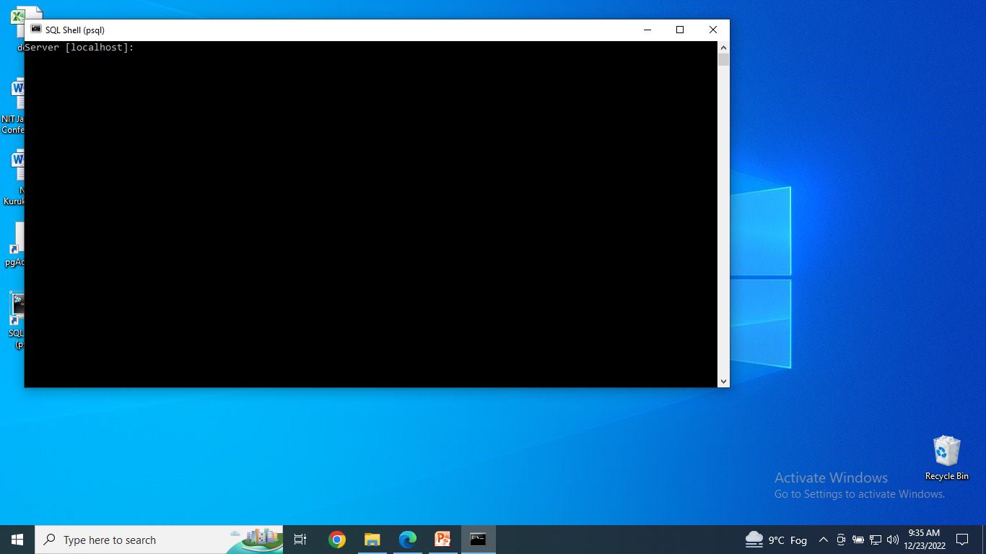
If a remote server then URL would come
Server is by default local host
So, simply Press Enter

Slide 6

Default database is postgres
So, simply Press Enter

Slide 7

The port 5432 is opened for the PostgreSQL database.
The TCP port uses port 5432 to listen to all the IP addresses on its server.
So, simply Press Enter

Slide 8
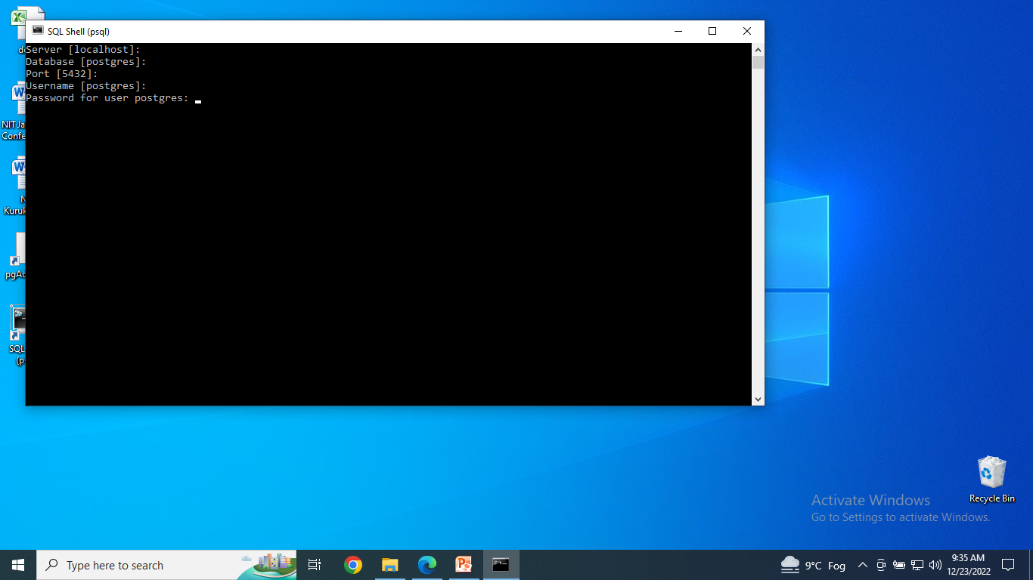
A default user is named postgres
You do not have to enter the name
So, simply Press Enter

Slide 9
Write the password that was set while installing PostgreSQL
Password is admin(say)
Entered password wont be displayed
But if it is right then the next step will come
Otherwise, error message will come

Slide 10
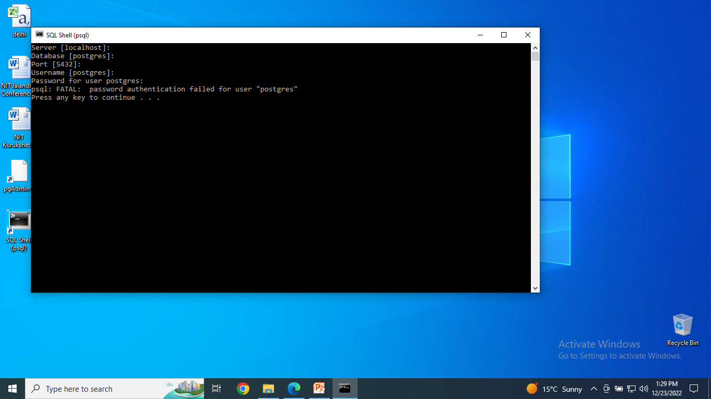
Password was incorrect

Slide 11
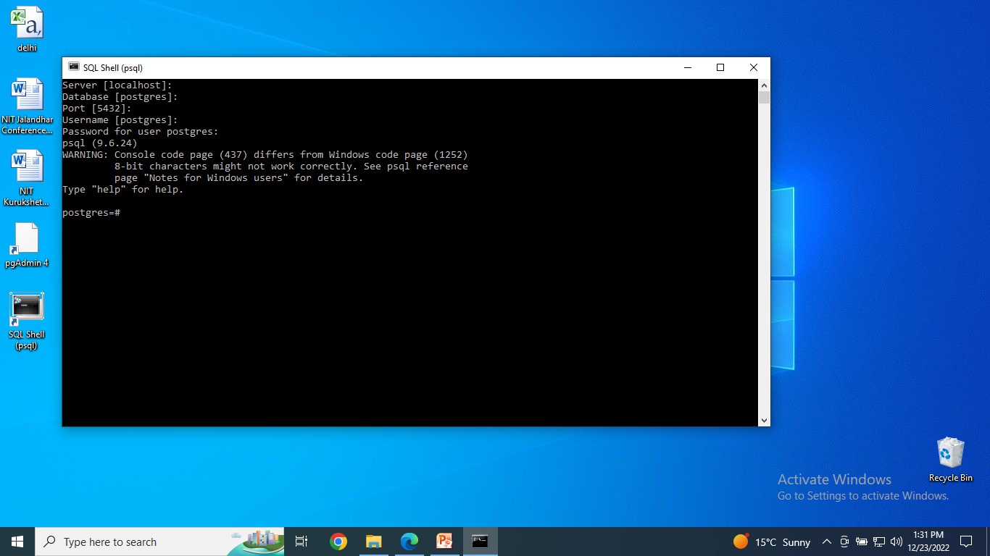
Password is correct

Slide 12
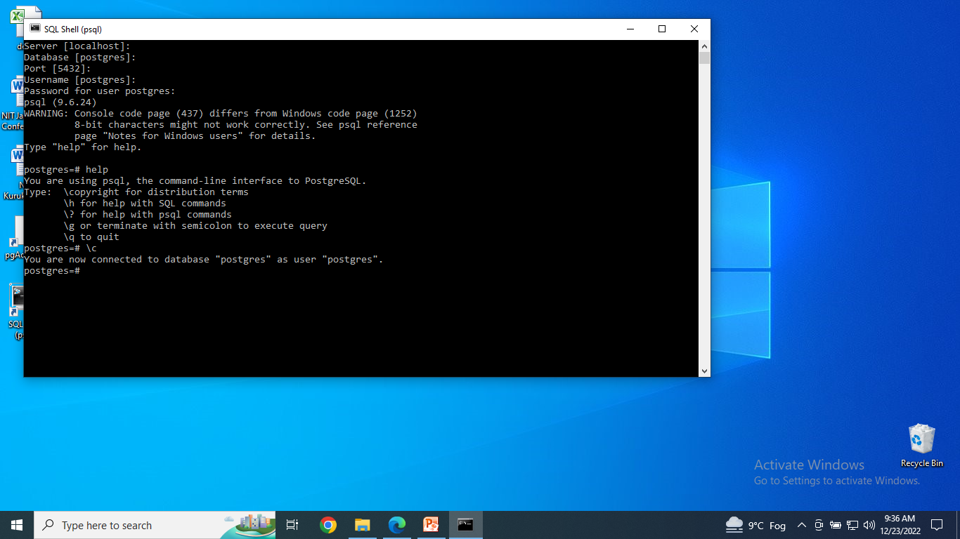
Type help
5 options are shown
\copyright
\h for help with sql commands
\? For help with psql commands
\g with semicolon to execute query
\q to quit

Slide 13
postgres=# is the Database SQL Prompt

Slide 14
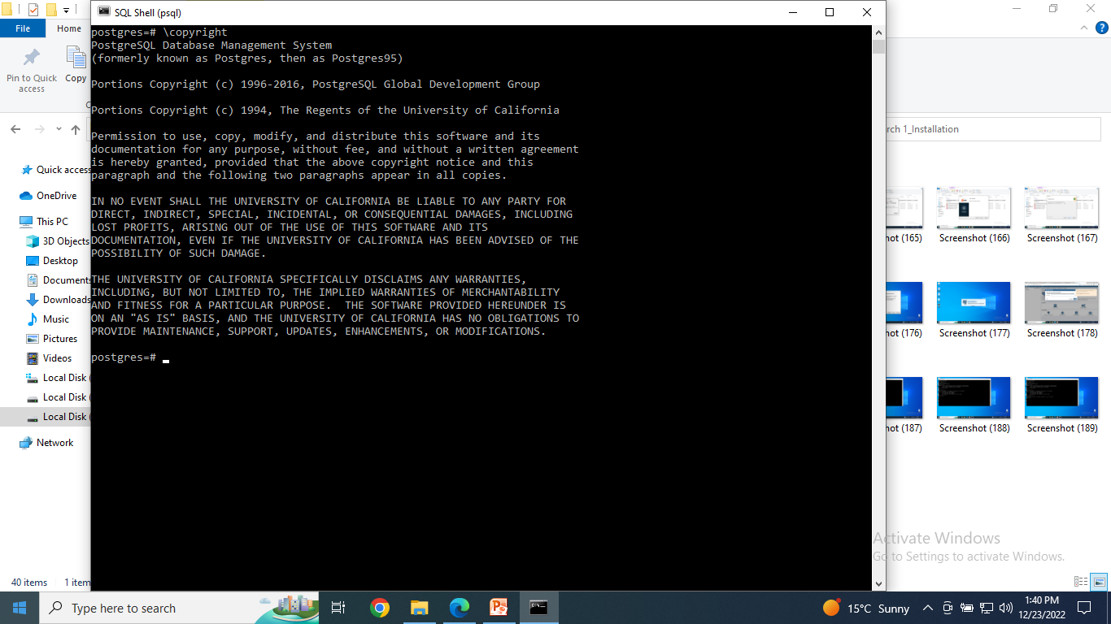
Type copyright

Slide 15
Former Name: Postgres
Then the name is : Postgres95
In 1994 : S/w was with Univ. of California
From 1996-2016: S/w is with PostgreSQL Global Development Group
Anyone can use, copy, modify and distribute the s/w provided Copyright Notice and 2 paragraphs are there

Slide 16
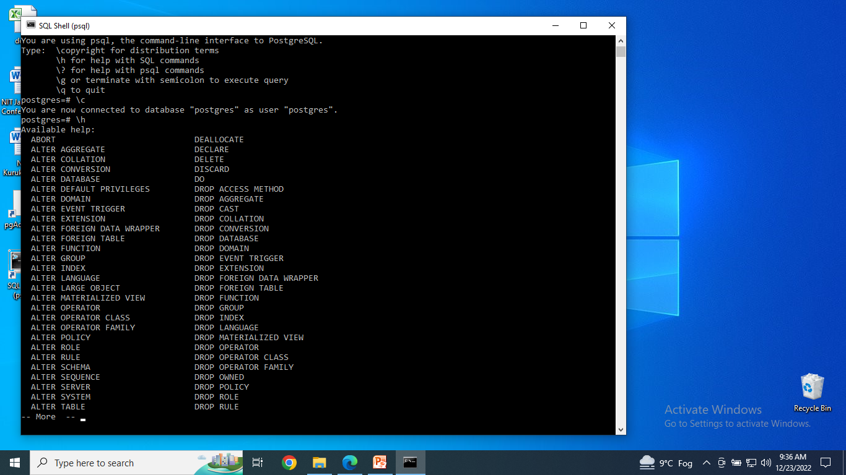
Type \h
List all SQL commands in the PostgreSQL.

Slide 17
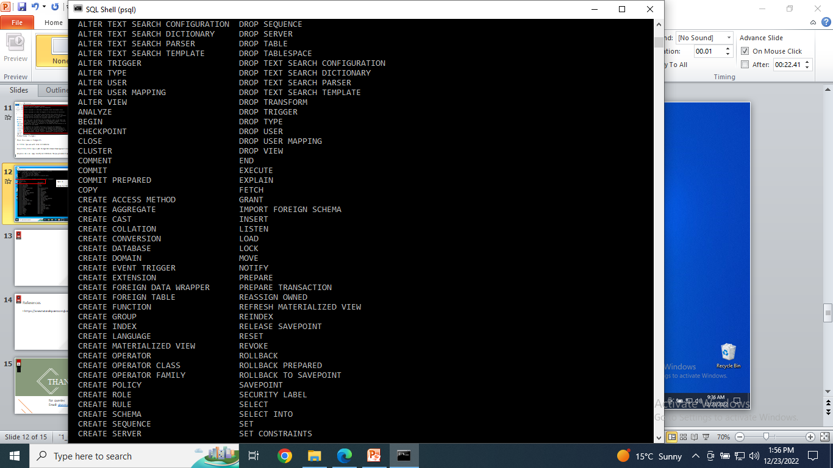
More SQL commands will come
By pressing Enter

Slide 18
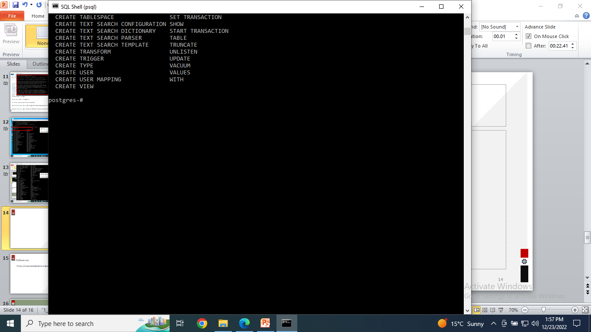
Some More SQL commands will come
By pressing Enter

Slide 19
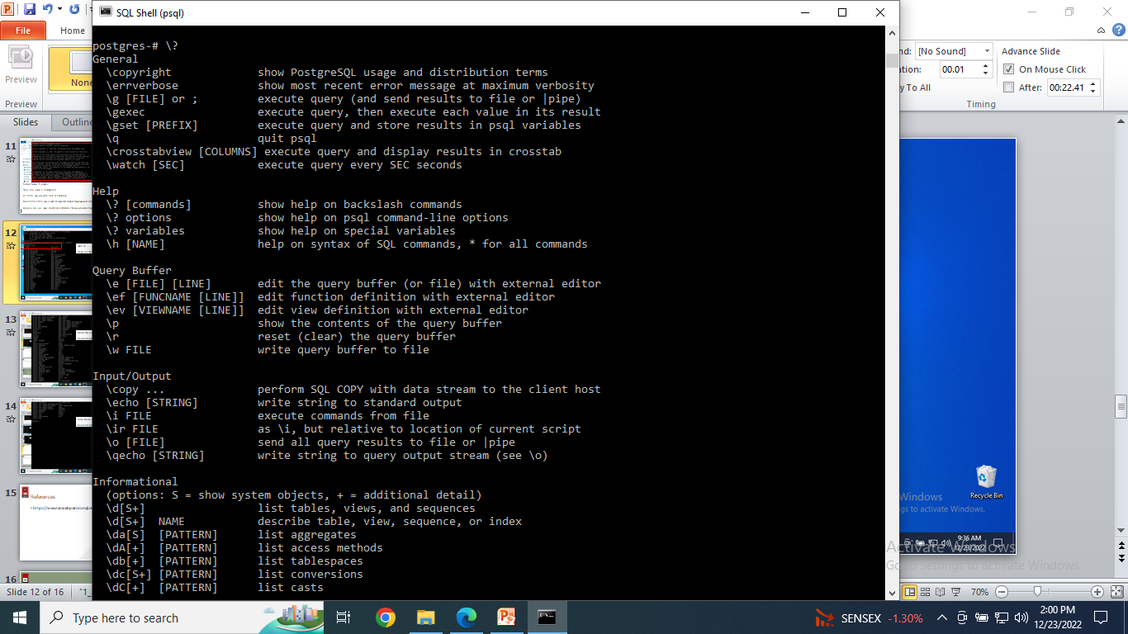
Type \?
Returns all of the commands available in PostgreSQL.

Slide 20
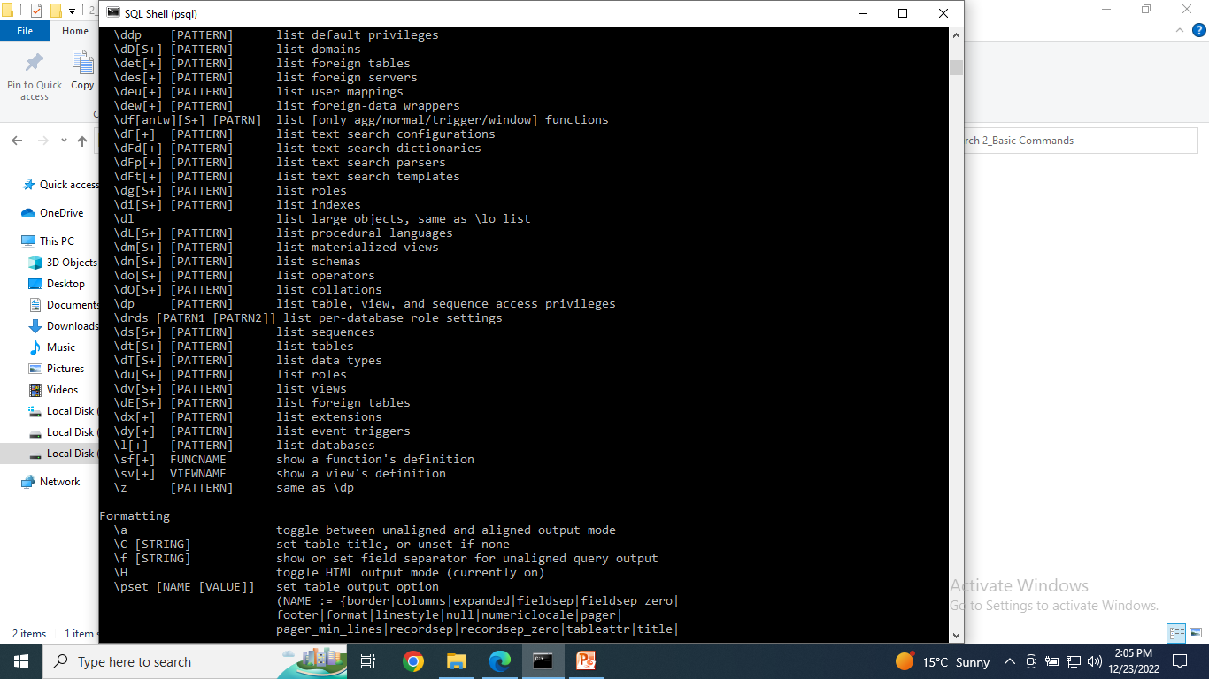
More commands will come
By pressing Enter

Slide 21
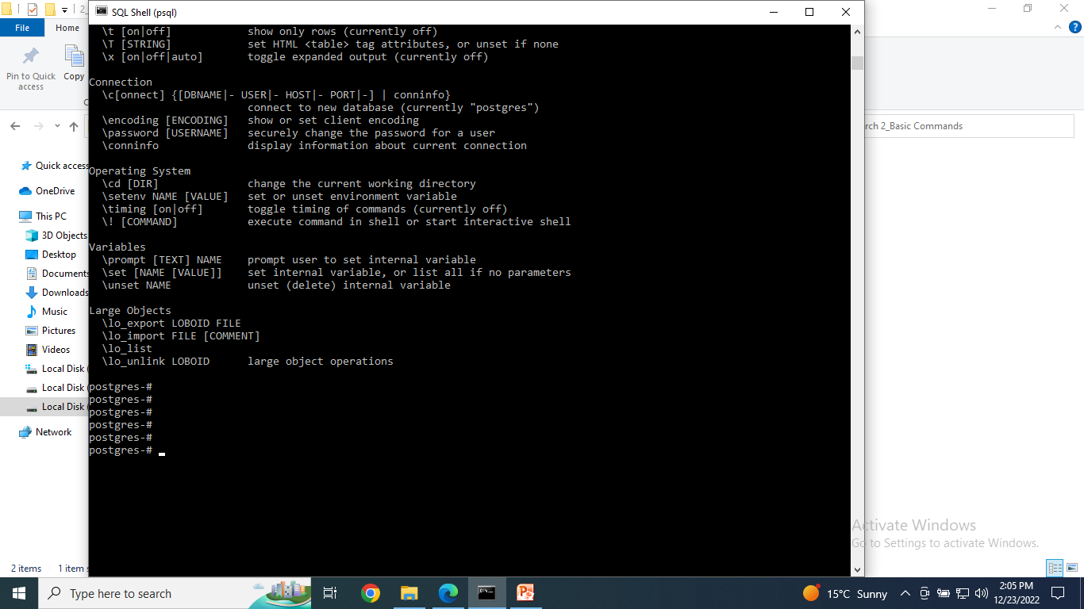
Some More commands will come
By pressing Enter

Slide 22
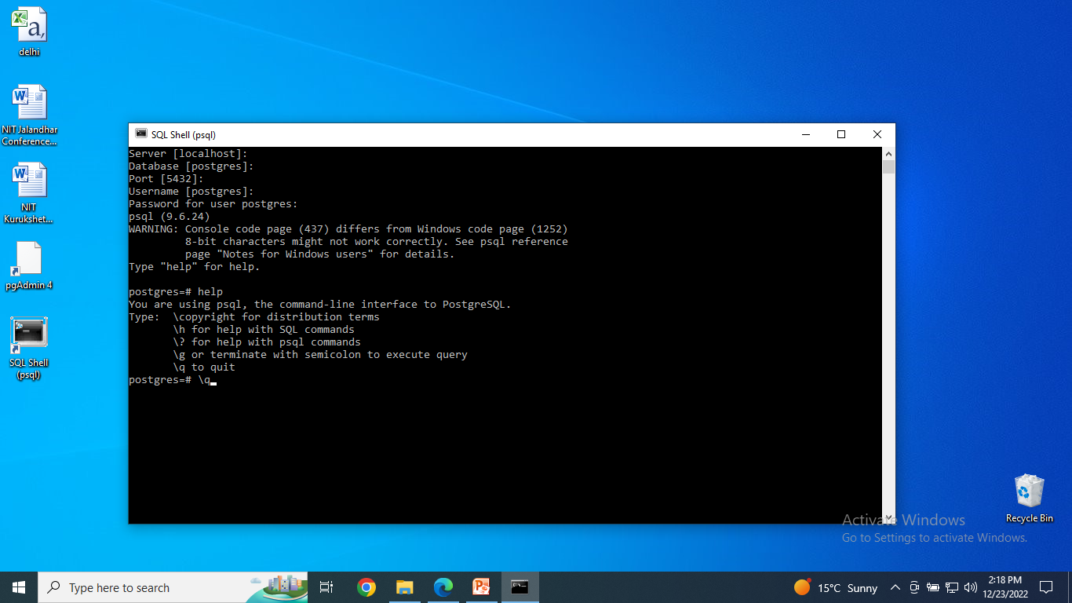

Slide 23
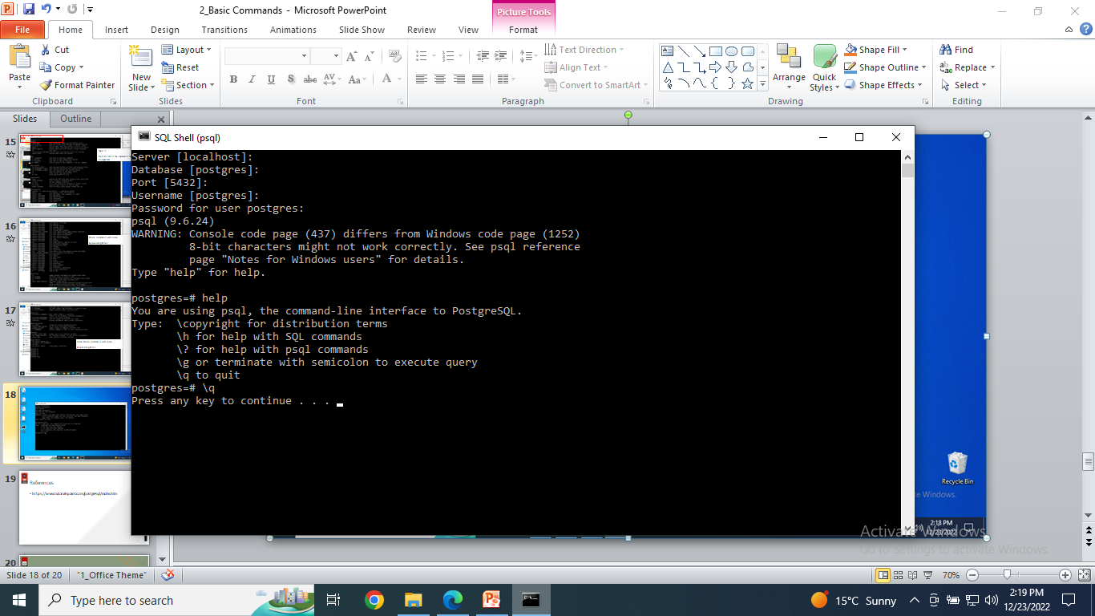
Type \q
To quit

Slide 24
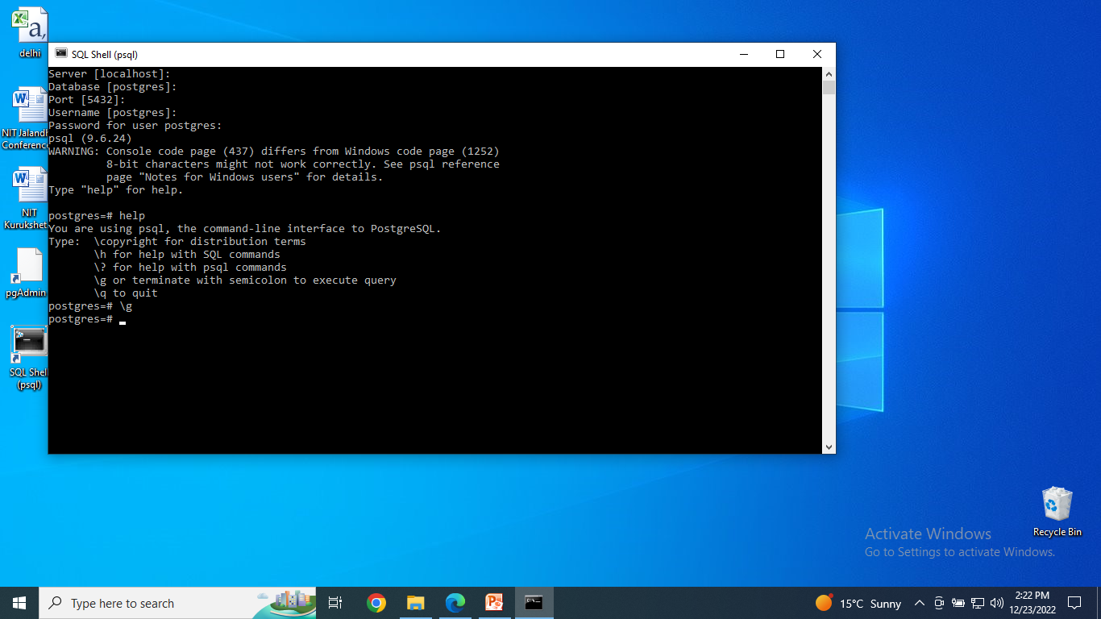
Type \g
To execute previous query
But no query was there
So nothing happened

Slide 25

SELECT version(); -🡪 written a command
Output came i.e. version is 9.6.24
To save time typing the previous command again, you can use \g command to execute the previous command:

Slide 26
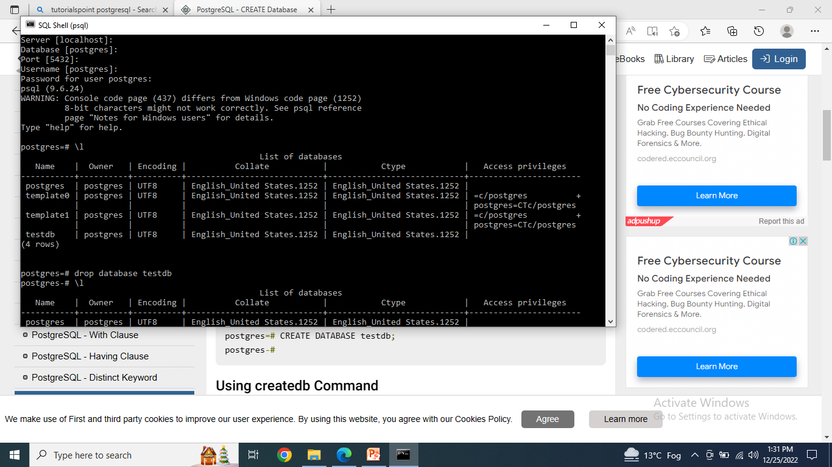
Type \l
Returns all of the databases available in PostgreSQL.

Slide 27
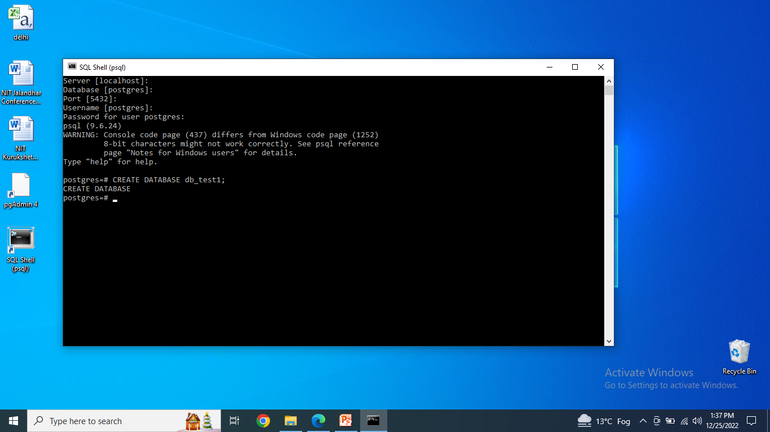
Syntax:
CREATE DATABASE name_of_database;

Slide 28
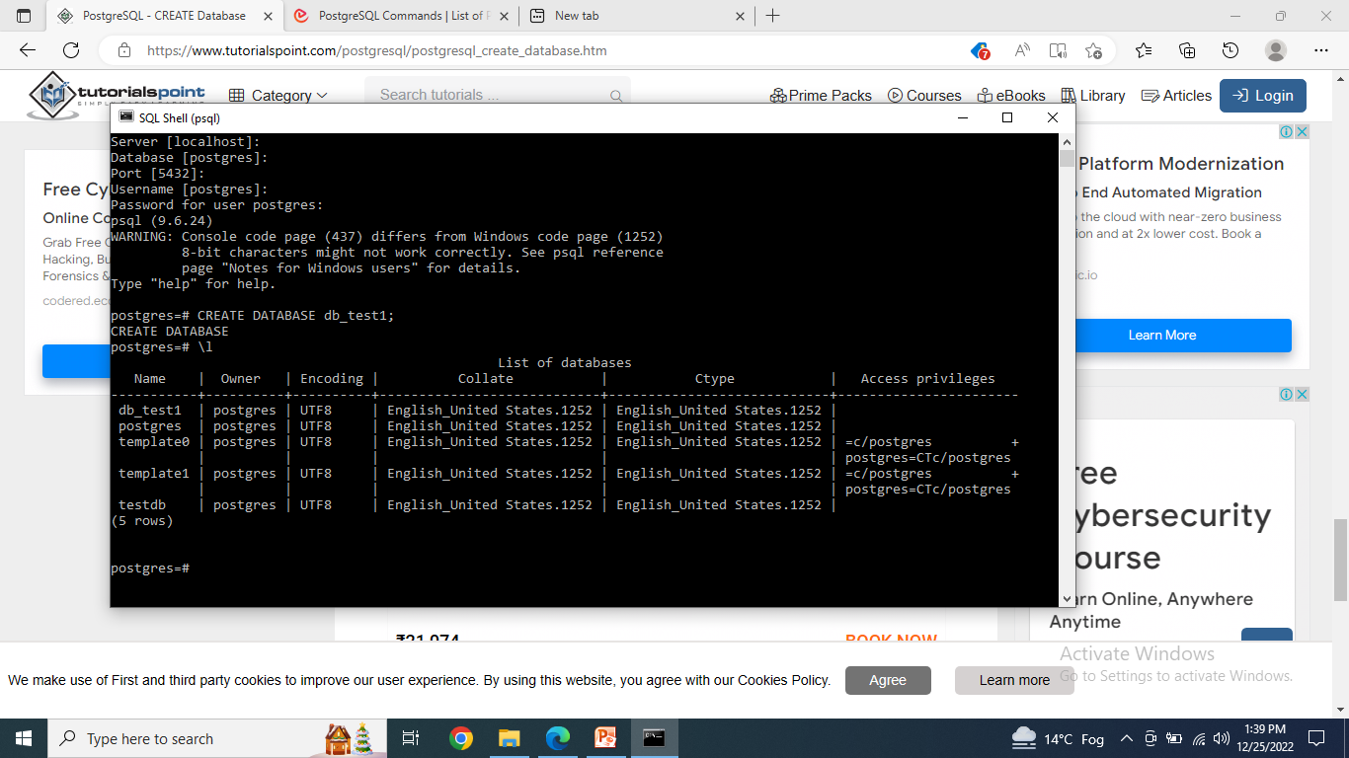
Type \l
Returns all of the databases available in PostgreSQL.
Now one more database is added i.e. db_test1

Slide 29
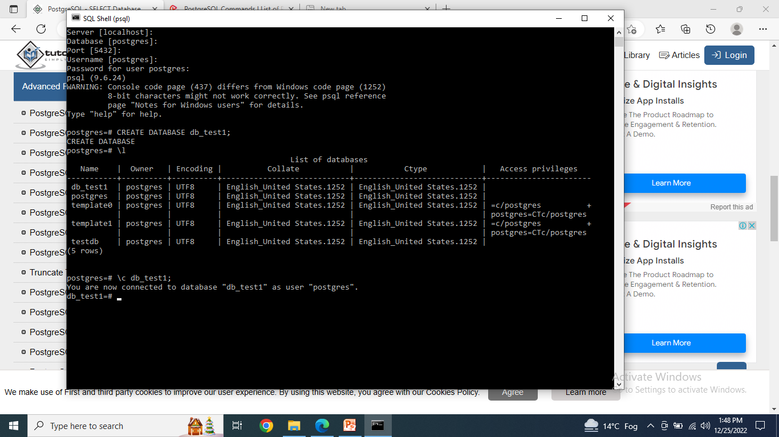
\c
Used to connect/select a desired database

Slide 30
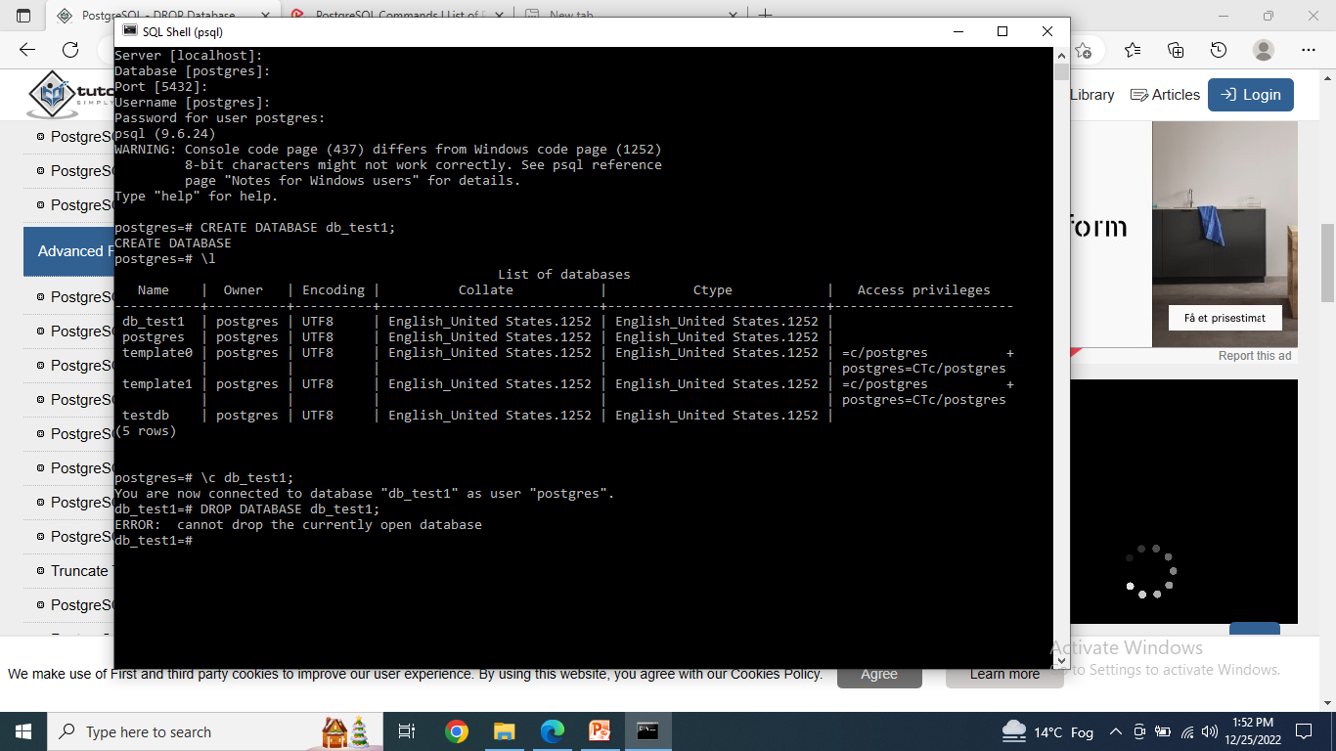
DROP DATABASE name_of_database
It drops the database
But you cannot drop the database in which you are logged in
So move to default database first

Slide 31
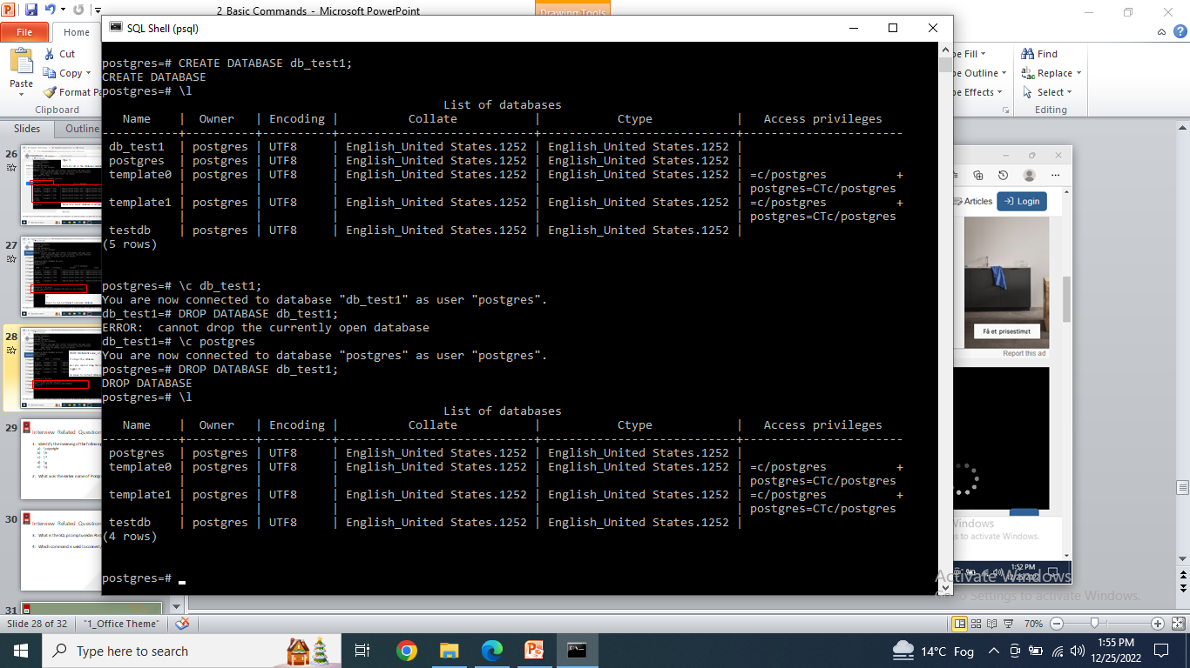
Connect to the default database i.e. postgreSQL
Then drop the other database i.e. db_test1
Use \l to find out the list of available databases
Now you will see that there are only 4 databases that left.

Slide 32
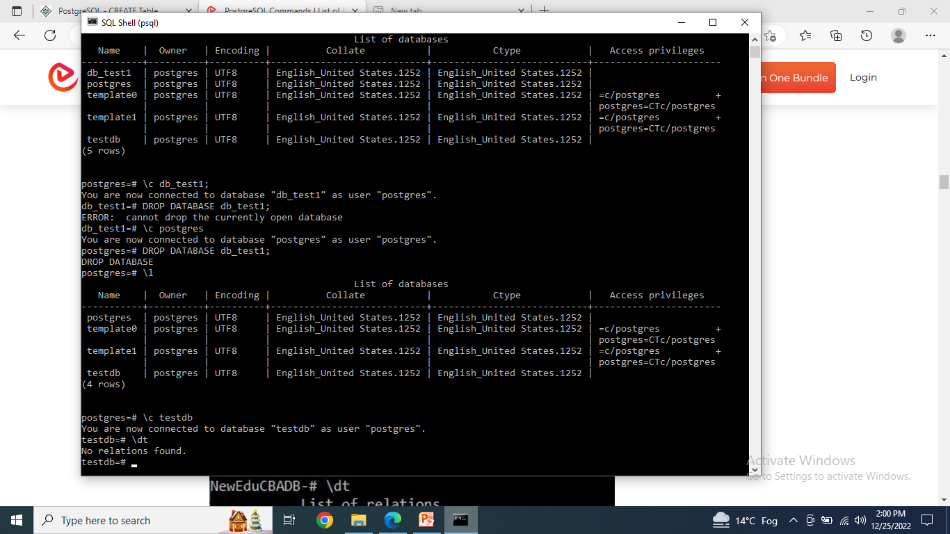
Now connect to testdb
And find out how many tables are there
For this use \dt command
dt stands for Database Tables

Slide 33
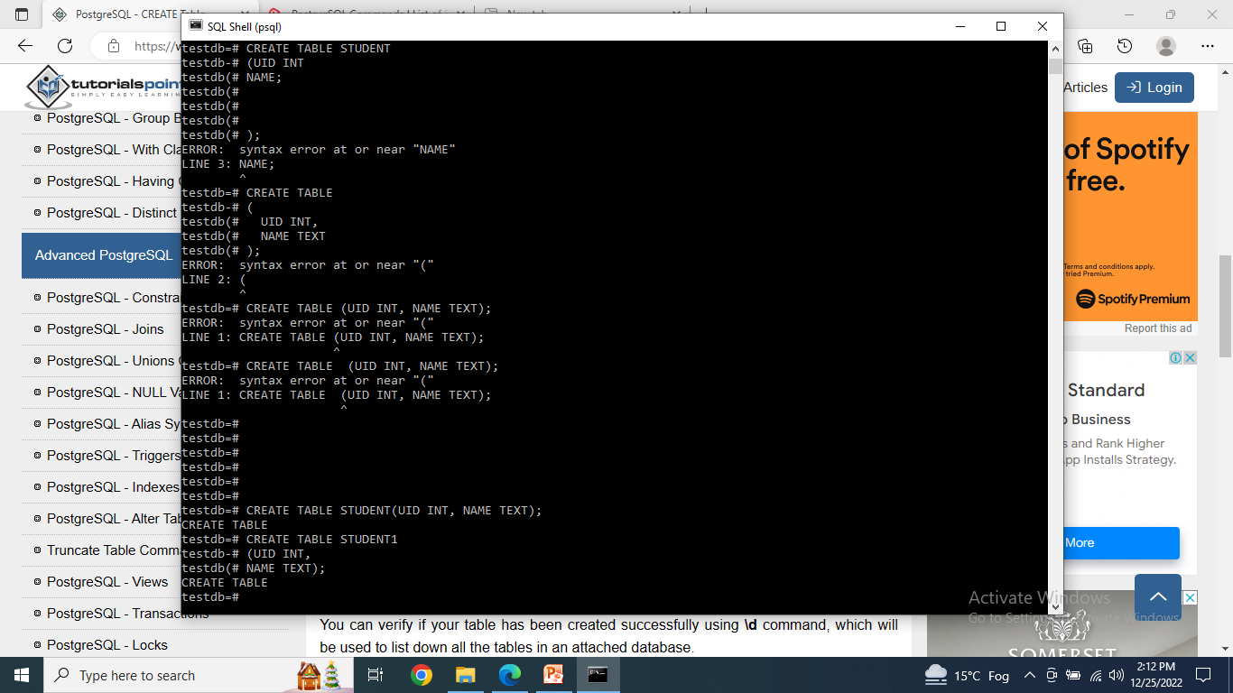
Syntax
CREATE TABLE table_name( column1 datatype, column2 datatype);

Slide 34
Syntax
CREATE TABLE table_name
( column1 datatype,
column2 datatype);

Slide 35
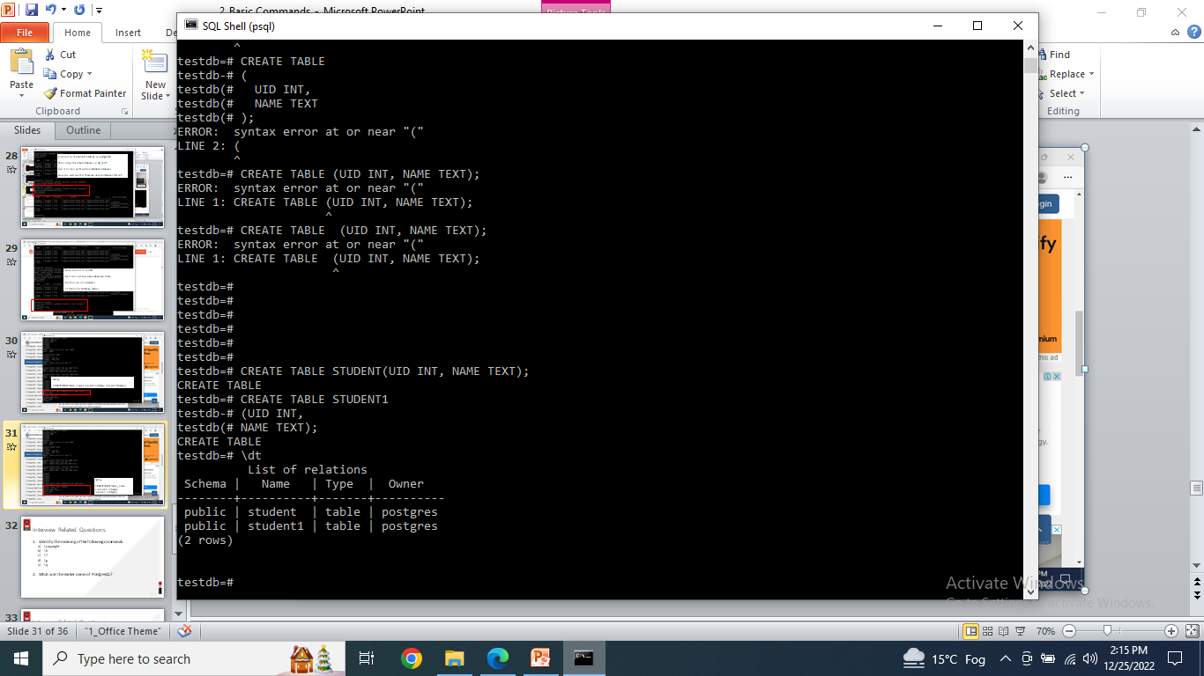
Use \dt command
Two tables will be visible in this database

Slide 36
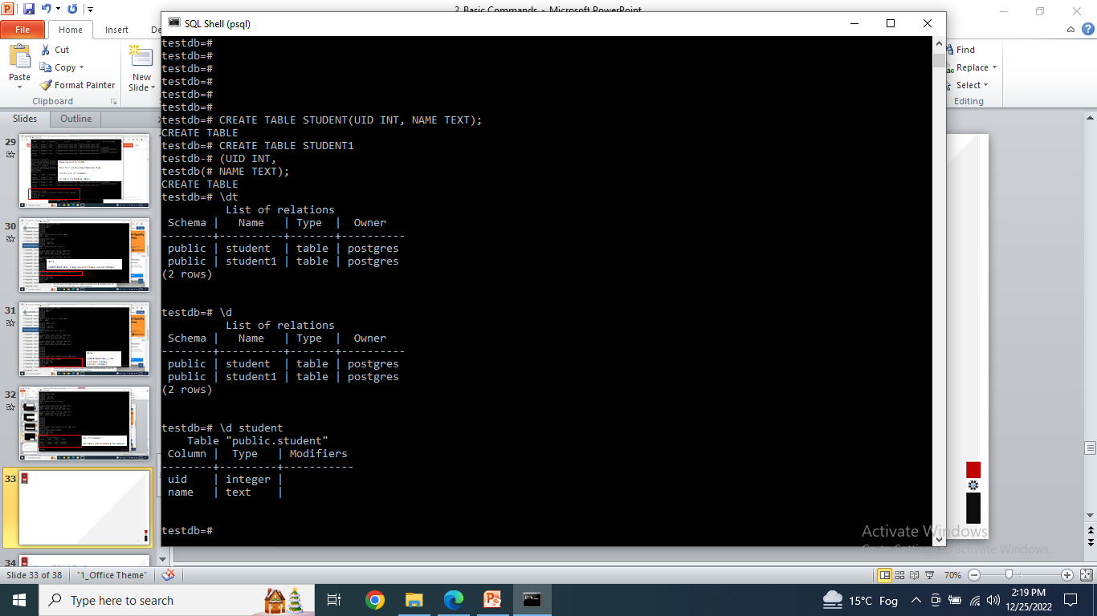
Use \d name_of_table
It is used to describe the table

Slide 37
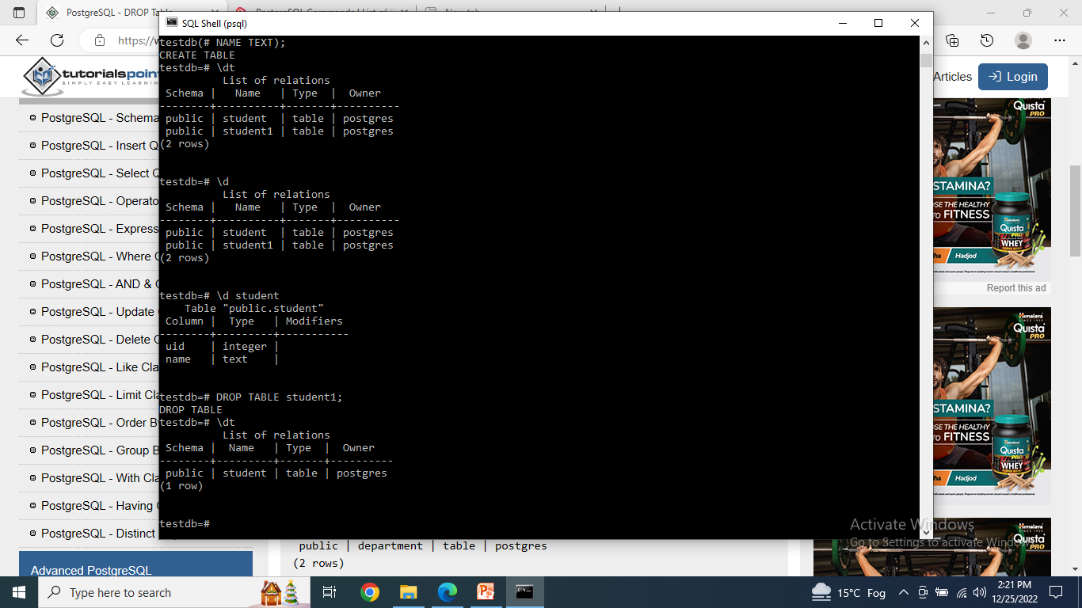
Syntax:
DROP TABLE table_name;

Slide 38
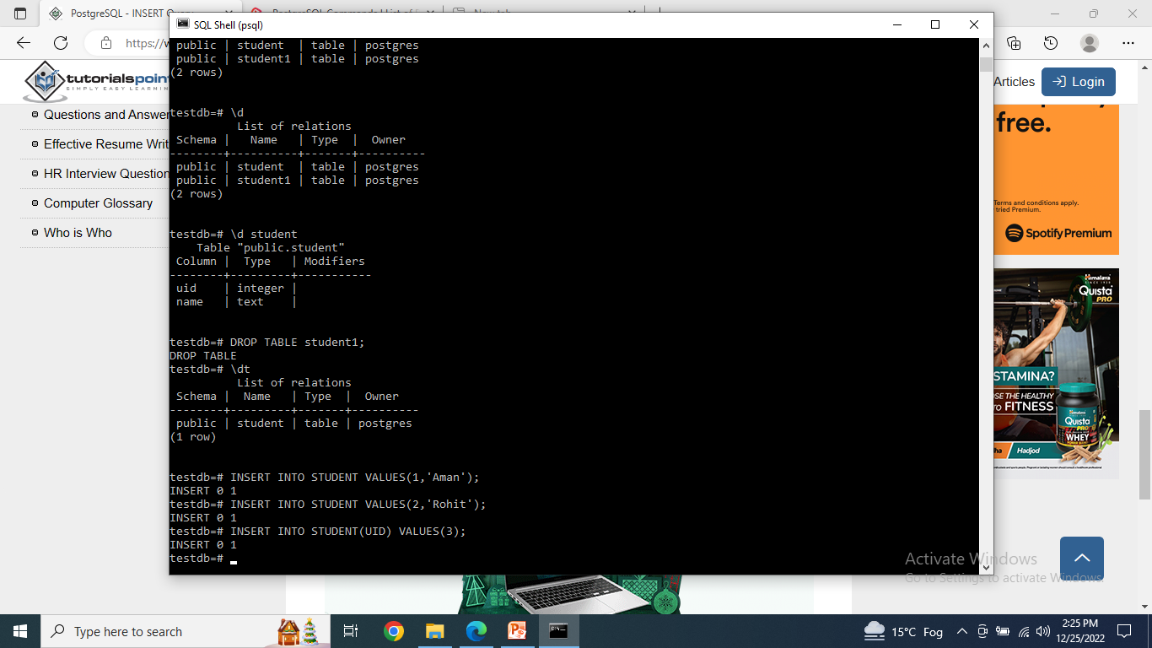
Syntax:
INSERT INTO TABLE_NAME (column1, column2) VALUES (value1, value2);

Slide 39
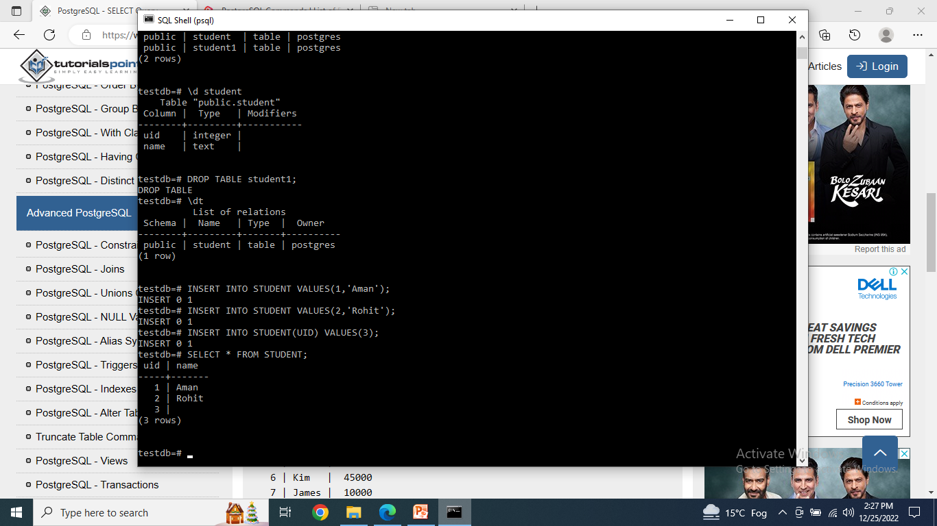
Syntax:
SELECT * FROM table_name;

Slide 40
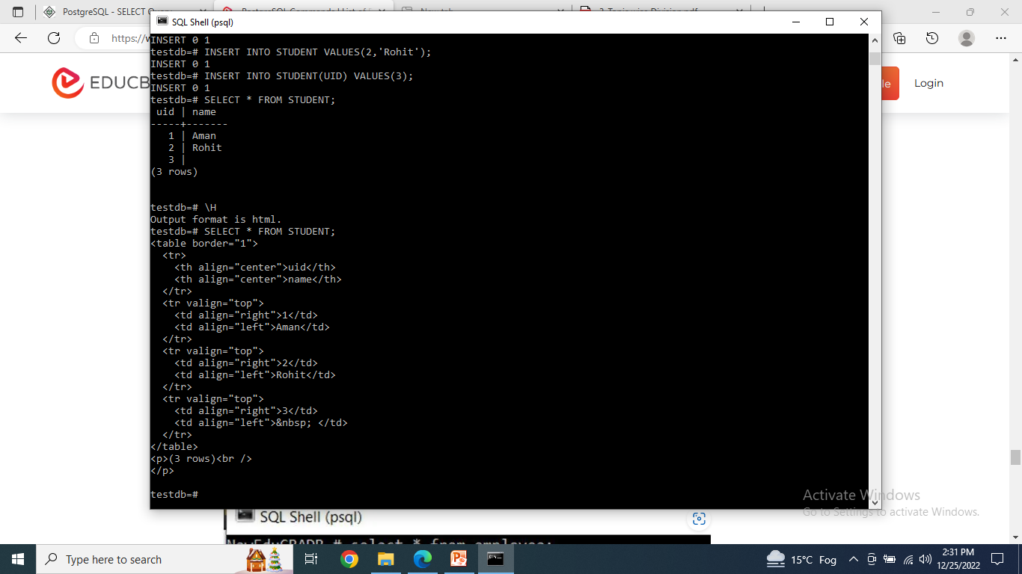
Syntax:
\H’ is used to format the output in the HTML format.

Slide 41
DATATYPES IN PostgreSQL
Datatype tells what kind of data is stored in the table fields.
PostgreSQL supports a wide set of Data Types.
Numeric Types
Character Types
Binary Types
Boolean Type

Slide 42
Numeric Types
Name | Storage Size | Description | Range
smallint | 2 bytes | small-range integer | -32768 to +32767
integer | 4 bytes | typical choice for integer | -2147483648 to +2147483647
bigint | 8 bytes | large-range integer | -9223372036854775808 to 9223372036854775807
decimal | variable | user-specified precision,exact | up to 131072 digits before the decimal point; up to 16383 digits after the decimal point
numeric | variable | user-specified precision,exact | up to 131072 digits before the decimal point; up to 16383 digits after the decimal point
real | 4 bytes | variable-precision,inexact | 6 decimal digits precision

Slide 43
Numeric Types
double precision | 8 bytes | variable-precision,inexact | 15 decimal digits precision
smallserial | 2 bytes | small autoincrementing integer | 1 to 32767
serial | 4 bytes | autoincrementing integer | 1 to 2147483647
bigserial | 8 bytes | large autoincrementing integer | 1 to 9223372036854775807

Slide 44
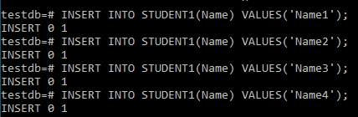
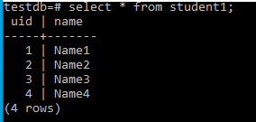
Example

Slide 45
Character Types
S. No. | Name & Description
1 | character varying(n), varchar(n) variable-length with limit
2 | character(n), char(n) fixed-length, blank padded
3 | text variable unlimited length

Slide 46
Binary Types
Name | Storage Size | Description
bytea | 1 or 4 bytes plus the actual binary string | variable-length binary string

Slide 47
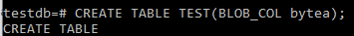
Example
Output is in hexadecimal form
The “hex” format encodes binary data as 2 hexadecimal digits per byte.
Starting \x sequence

Slide 48
Boolean Type
Name | Storage Size | Description
boolean | 1 byte | state of true or false

Slide 49
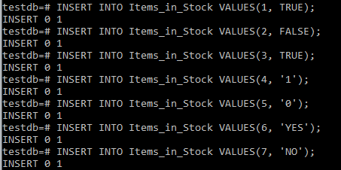
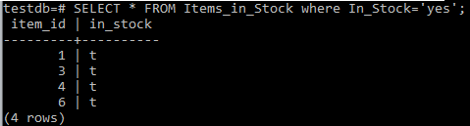
Example

Slide 50
Interview Related Questions
Identify the meaning of the following commands:
\copyright
\h
\?
\g
\q
What was the earlier name of PostgreSQL?

Slide 51
Interview Related Questions
What is the SQL prompt used in PostgreSQL?
Which command is used to connect/select a desired database?
Can we drop a database in PostgreSQL while we are working in it?
Which command is used to find how many tables are there in the database?

Slide 52
Interview Related Questions
Which command is used to describe a table?
If we want to see the output in HTML format then which command is used?
What are the various types of data types supported by PostgreSQL?

Slide 53

THANK YOU
For queries
Email: vineet.e13038@cumail.in

Slide 54
Interview Related Questions & Answers
Identify the meaning of the following commands:
\copyright
\h for help with sql commands
\? For help with psql commands
\g with semicolon to execute query
\q to quit
What was the earlier name of PostgreSQL? Postgres and then Postgres95

Slide 55
Interview Related Questions & Answers
What is the SQL prompt used in PostgreSQL? postgres=#
Which command is used to connect/select a desired database? \c
Can we drop a database in PostgreSQL while we are working in it? No
Which command is used to find how many tables are there in the database? \dt

Slide 56
Interview Related Questions & Answers
Which command is used to describe a table? \d table_name;
If we want to see the output in HTML format then which command is used? \H and then write the select query
What are the various types of data types supported by PostgreSQL?
Numeric Types
Character Types
Binary Types
Boolean Type

